Slide 1
Notify MyHabit
By Rohit Chandupatla & Akanksha Sudhagoni

Slide 2
Our Application
The objective of our web application is to display a habit of a person on basis of the weekday. Once the user hits on the habit, it shows some images, descriptions in the text, check the inbox to know either the habit is done today or not. If the user completes the habit for the day then we can add some points or credits to the account.

Slide 3
Why this app?
This app helps us in keeping up a track with our daily habits where they could see what habits a person would do for that particular day and earn points as they get done with it.

Slide 4
Who will use it?
This application could be used by everyone who thinks and like to keep a check on the daily habits.

Slide 5
What is the main purpose?
Helps the users in notifying them with a particular habit of that particular day and helps them in keeping up a track on it.

Slide 6
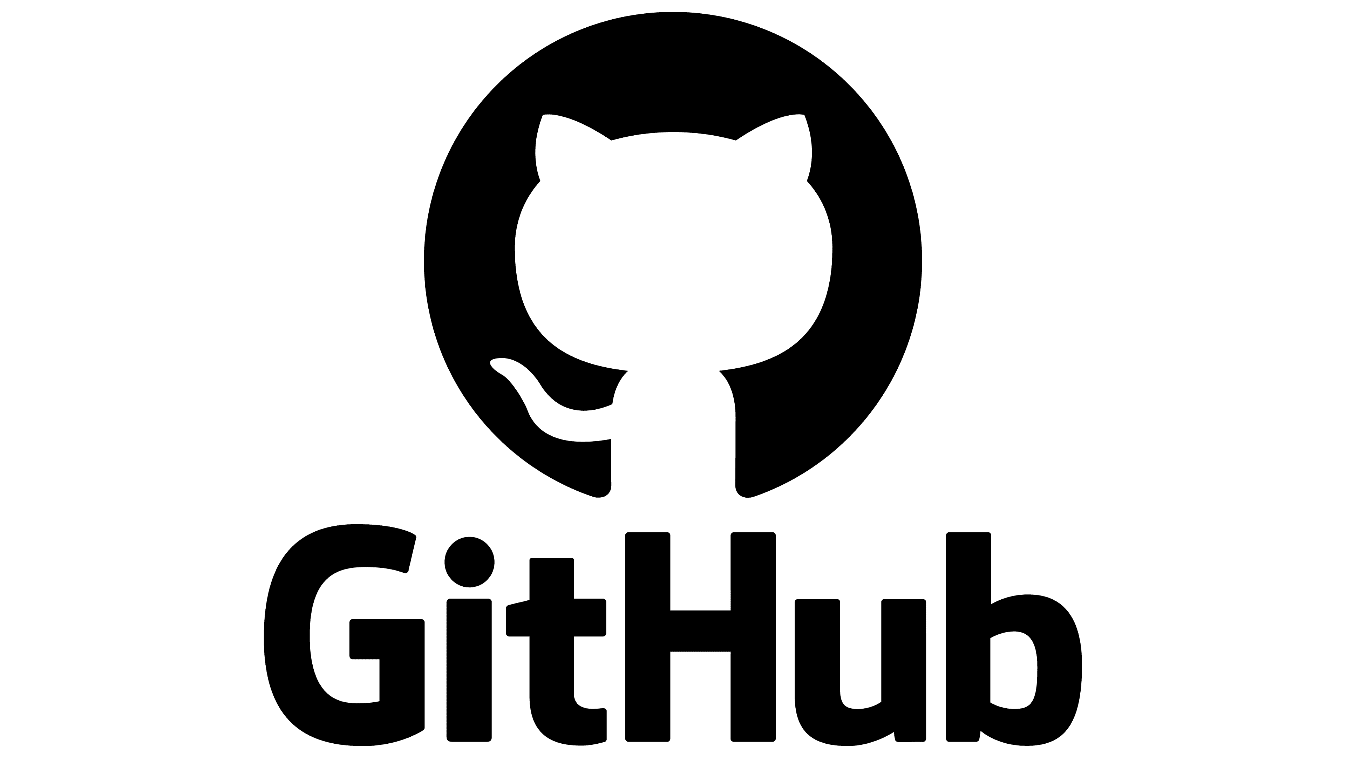
GitHub is a code hosting platform for version control and collaboration

Slide 7
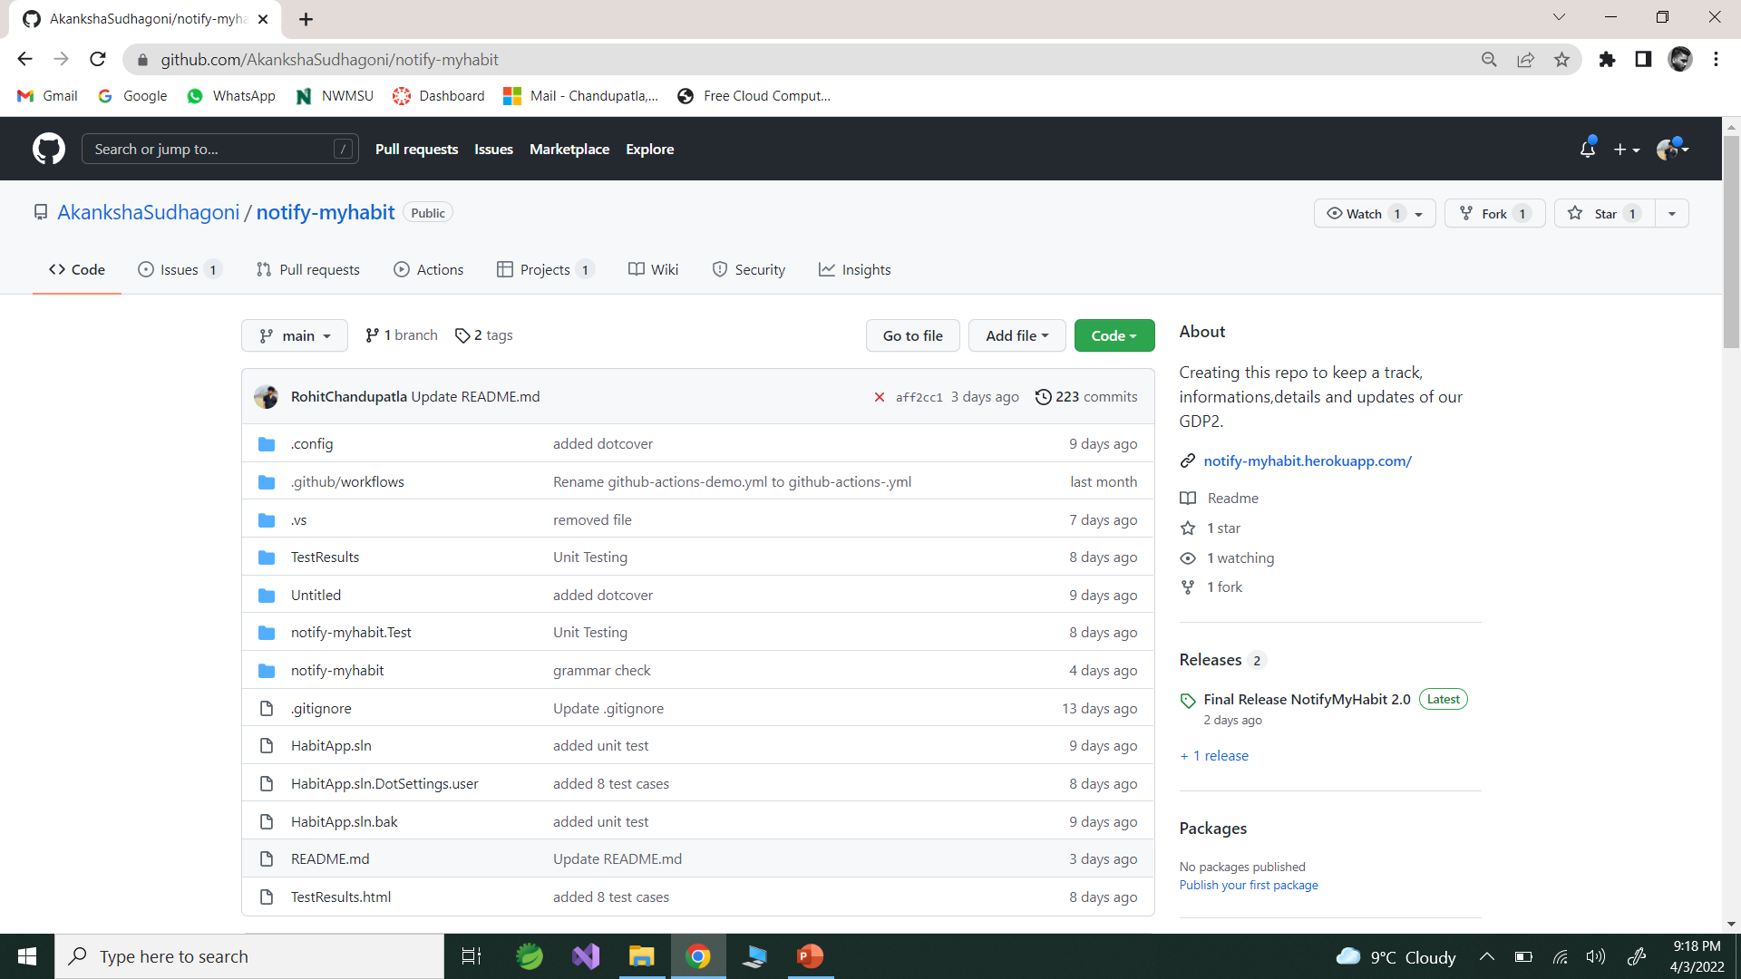

Slide 8

Heroku
Heroku is a container-based cloud Platform as a Service. Developers use Heroku to deploy, manage, and scale modern apps

Slide 9
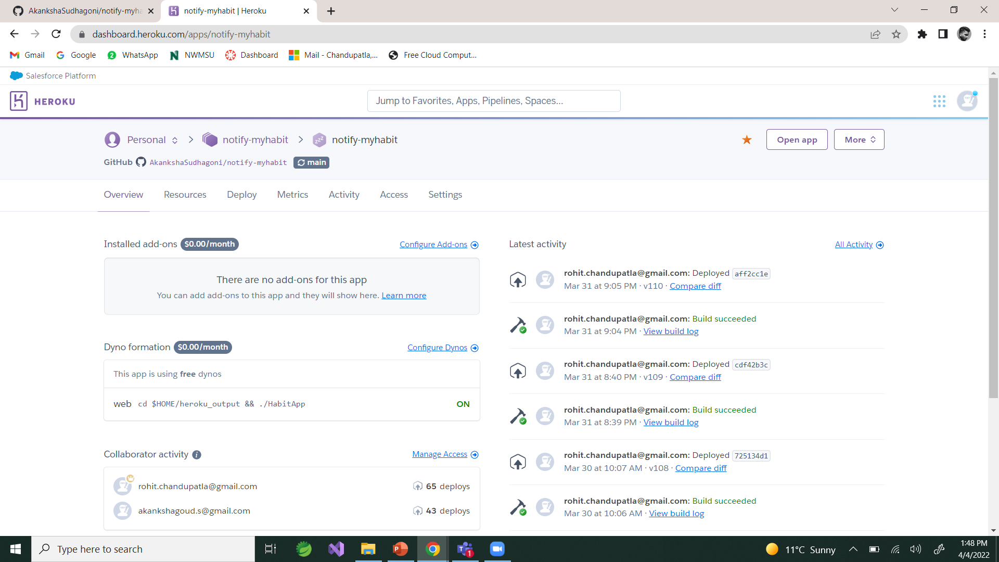

Slide 10
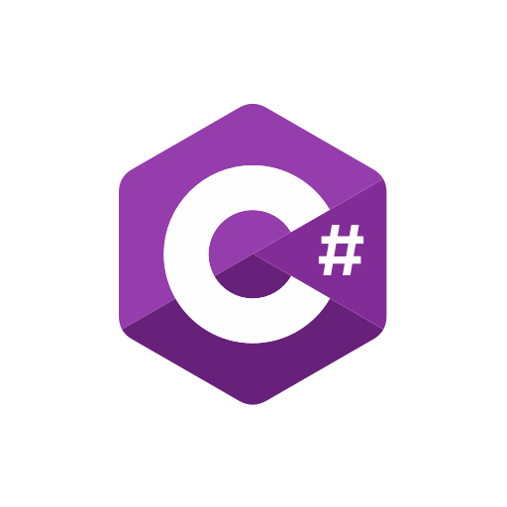

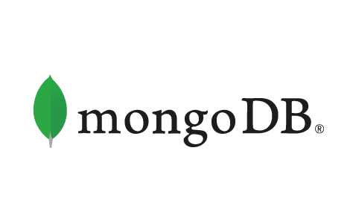


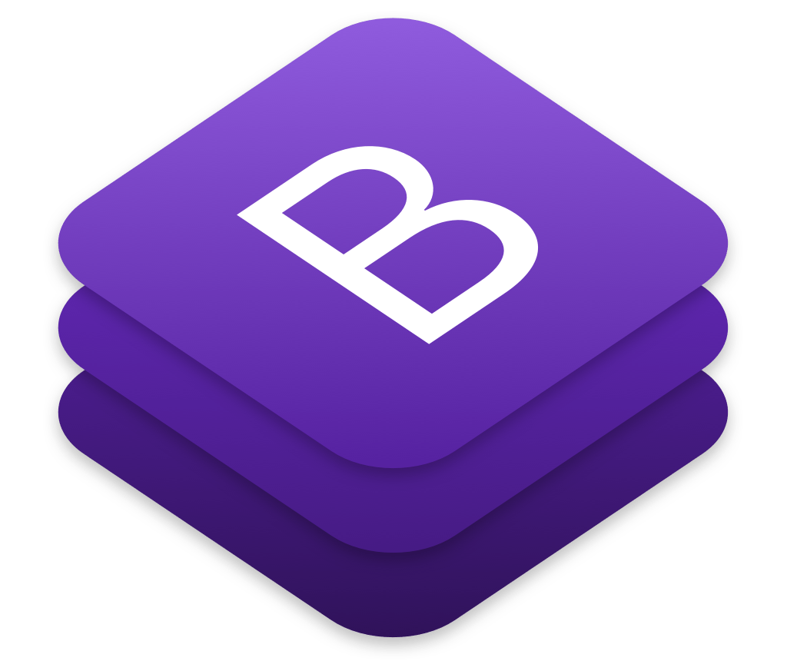
Technological stack

Slide 11
Why this stack ?
We faced multiple challenges when working with several stacks and earned some experience, so we decided to attempt a new stack to get experience with a new language that we hadn't worked with before, therefore this is our first project using C#/.NET.

Slide 12
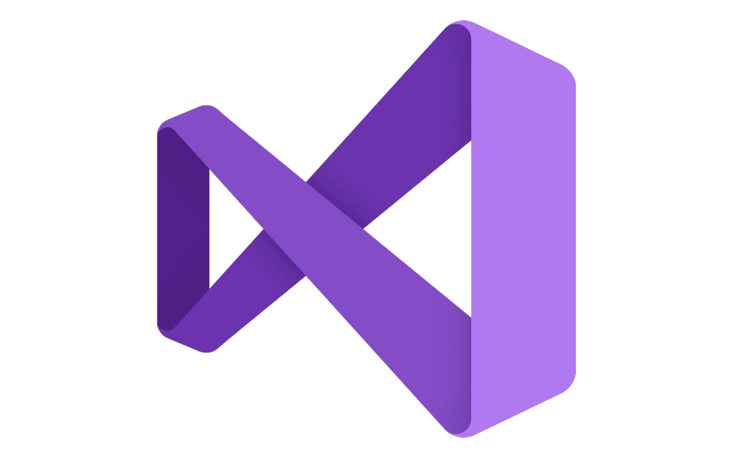
Integrated Development Environment
Microsoft Visual Studio is an integrated development environment from Microsoft. It is used to develop computer programs, as well as websites, web apps, web services and mobile apps.

Slide 13
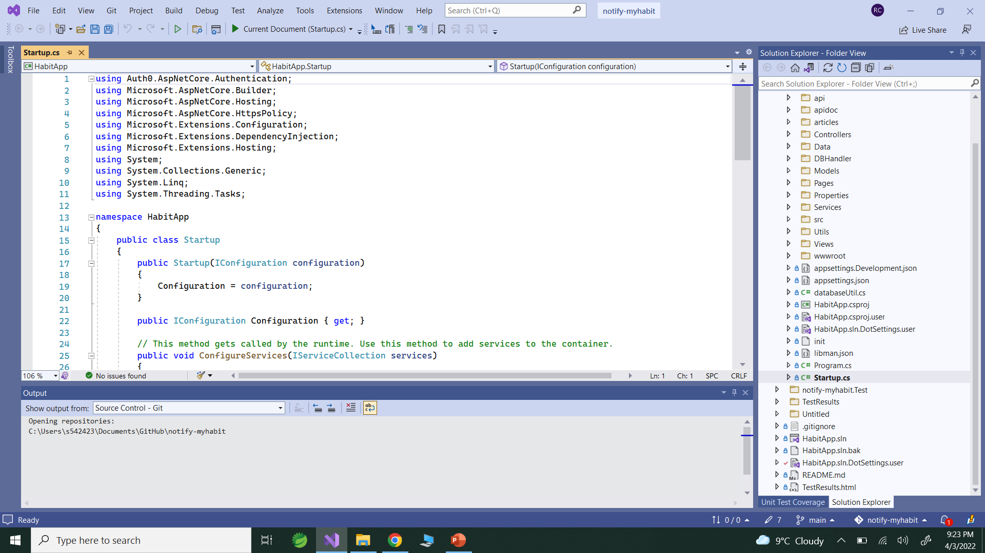

Slide 14

Security analysis Codacy automates code reviews and monitors code quality on every commit and pull request reporting back the impact of every commit or pull request, issues concerning code style, best practices, security, and many others.

Slide 15
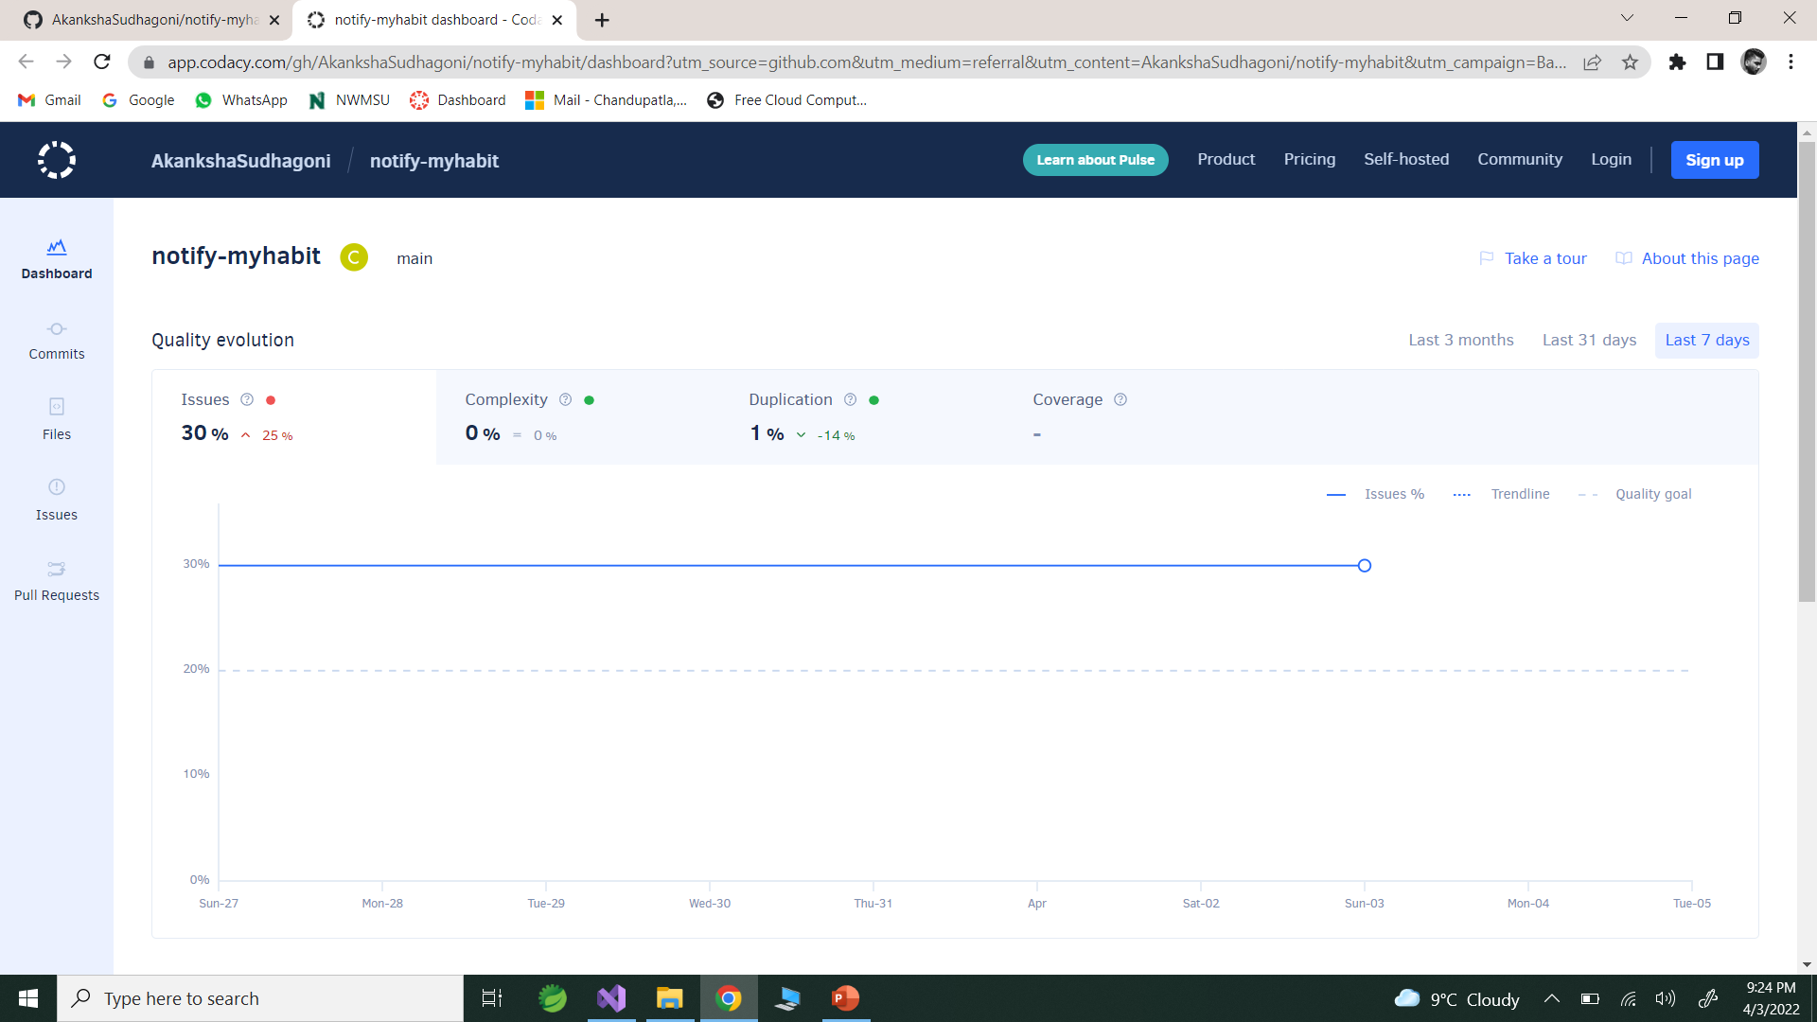

Slide 16

SonarCloud is the leading online service to catch Bugs and Security Vulnerabilities in your Pull Requests and throughout your code repositories. Thousands of rules to track down hard-to-find bugs and quality issues thanks to powerful static code analyzers.

Slide 17
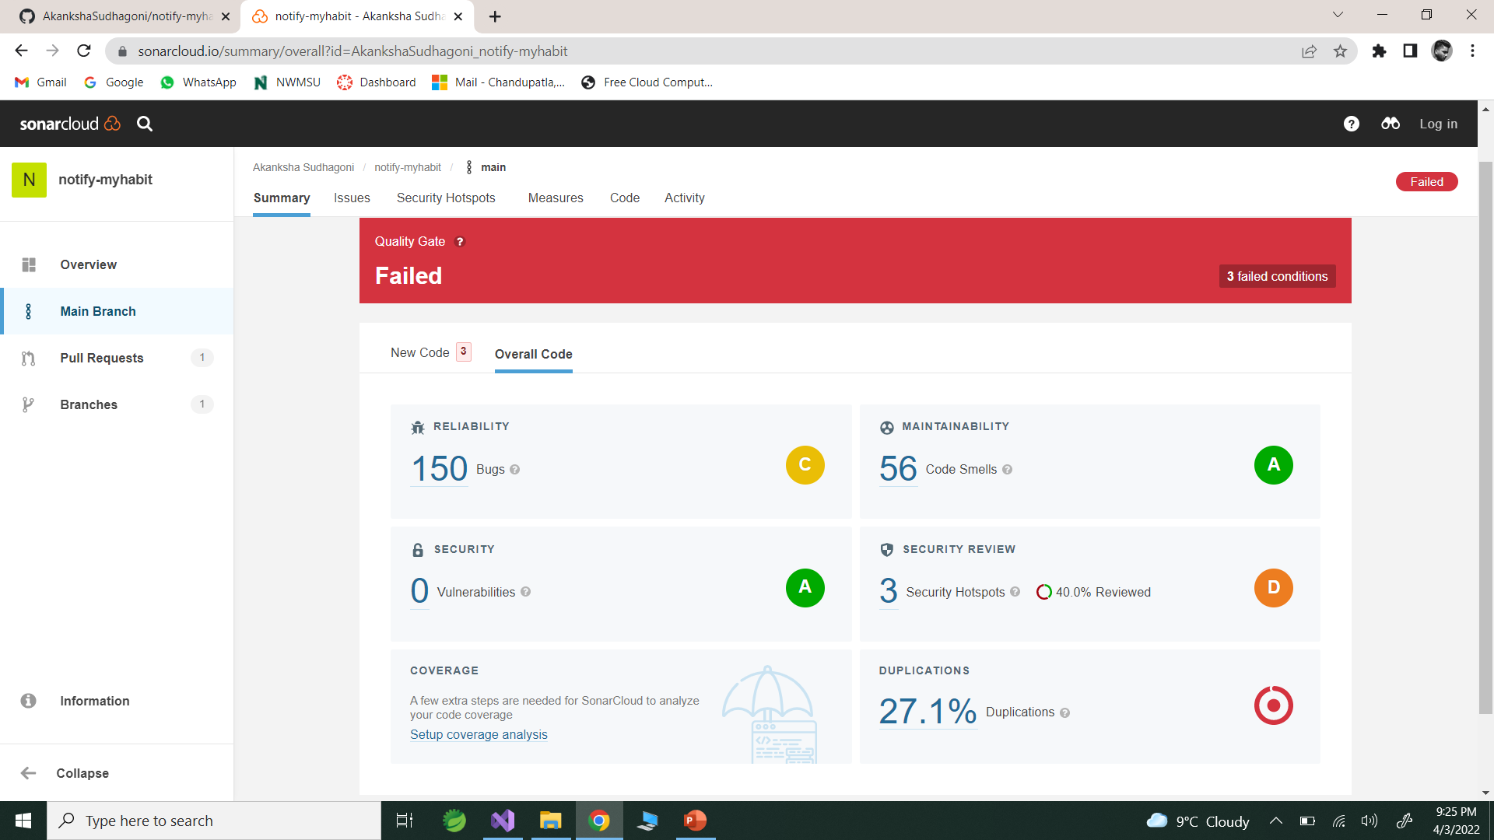

Slide 18
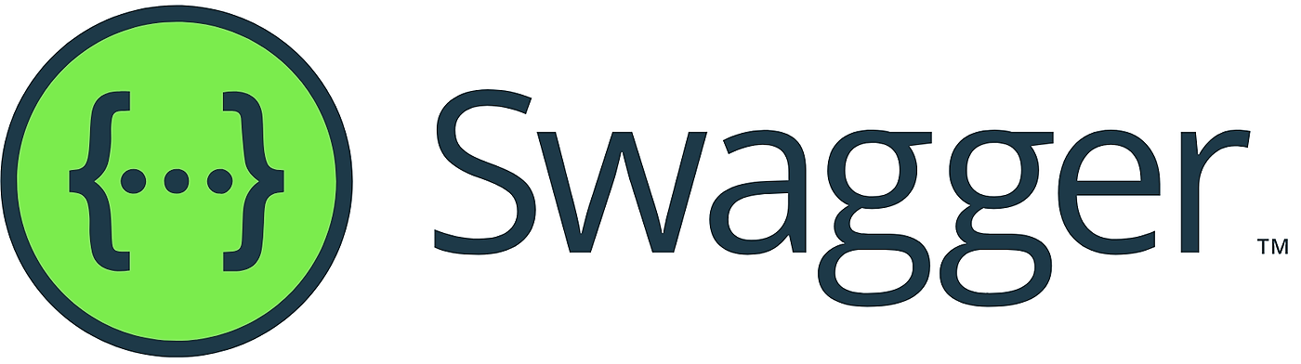
Swagger (OpenAPI) is a language-agnostic specification for describing REST APIs It allows both computers and humans to understand the capabilities of a REST API without direct access to the source code
Documentation Sites.

Slide 19
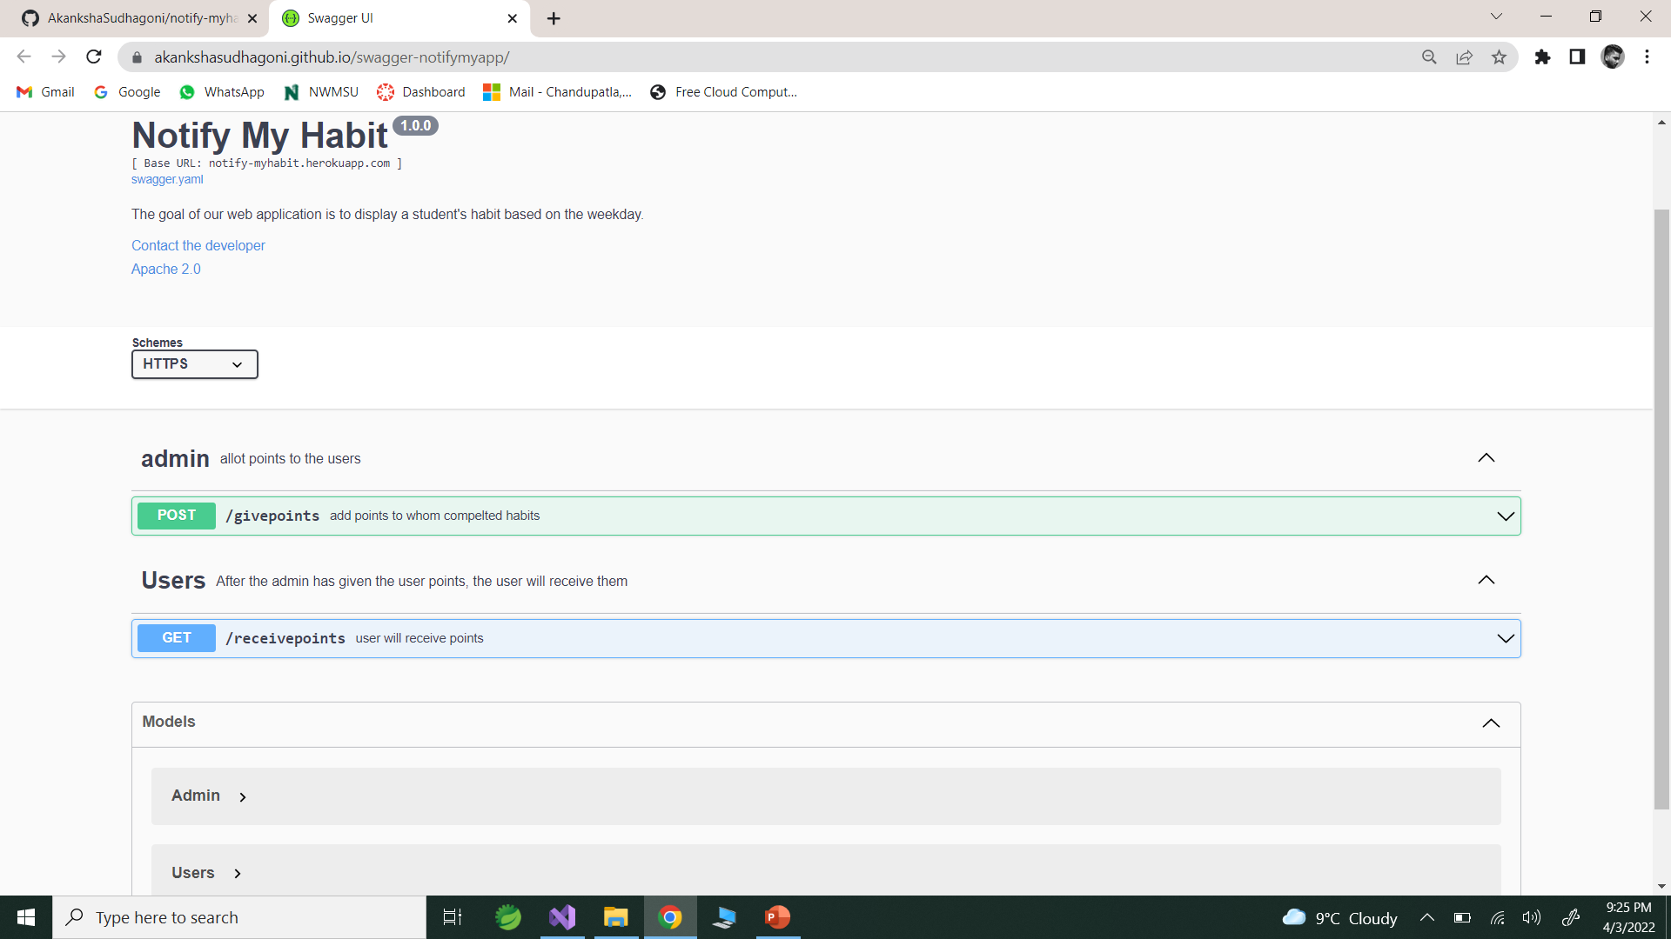

Slide 20

DocFX is an API documentation generator for . NET, which currently supports C#, VB and F#. It generates API reference documentation from triple-slash comments in your source code.

Slide 21
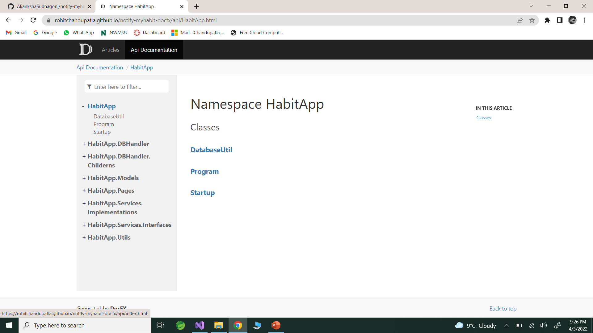

Slide 22

Unit Testing
Unit testing is a software development process in which the smallest testable parts of an application, called units, are individually and independently scrutinized for proper operation.
This testing methodology is done during the development process by the software developers.
There are 2 type of Unit Testing: Manual, and Automated.

Slide 23
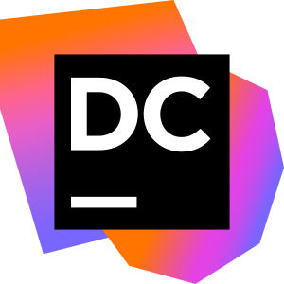
dotCover code coverage
JetBrains dotCover is a . NET unit test runner and code coverage tool that integrates with Visual Studio and JetBrains Rider. Make sure you know to what extent your code is covered with unit tests. dotCover calculates and reports statement-level code coverage in applications targeting .

Slide 24
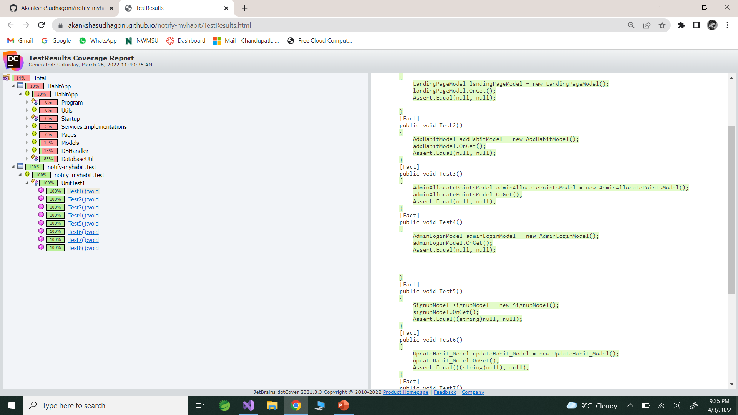

Slide 25
Lessons learned
We gained some experience in C#/.NET
We documented our app for the first time.
We learned how to do unit testing.
This project taught us about swagger.
This project taught us about security analysis.
I gained more GitHub experience by working on this project. We learned about issues, wikis, project boards, milestones, pull requests, and actions.

Slide 26
Links to our sites
GitHub
Codacy
SonarCloud
Swagger
DocFx -
Code Coverage report

Slide 27

Thank you

